Slide 1
Capstone Project: Loan Eligibility Assessment
By Balkis

Slide 2
Problem Statement – About the dataset
Dream Housing Finance company deals in all kinds of home loans. They have presence across all urban, semi urban and rural areas.
Current Process (Turnaround time of a few weeks)
Customer goes to the Company
Fills an Application
Loan Eligibility is assessed
Loan is provided to customer
Goal:
Automate the Eligibility Assessment Process
Expediate assessment on their current pipeline of loans requests

Slide 3
Project Assumptions, Limitations and success metrics
Assumptions
Goals & Metrics
Limitations
Past loan eligibility assessments are accurate
No other additional datapoints aside from the data features available within the dataset are relevant for the assessment
No limits in loan provision for customers
Credit History of a customer is static and would not change over time.
Each customer only takes on 1 loan.
Every customer is a new applicant, no repeat customers on dataset
Identify efficient prediction models for loan status assessment and loan amount estimation:
Low errors
Better accuracy,
Minimal multicollinearity
Metrics:
RMSE and R2 score for linear regression
Accuracy for classification models
Silhouette score for clustering models
Online Application forms are subject to human error
Credit history may change over time as more debt is undertaken by the customers. The models are point-in-time models. In reality, the credit history is regularly assessed for the customer's ability to make repayments.

Slide 4
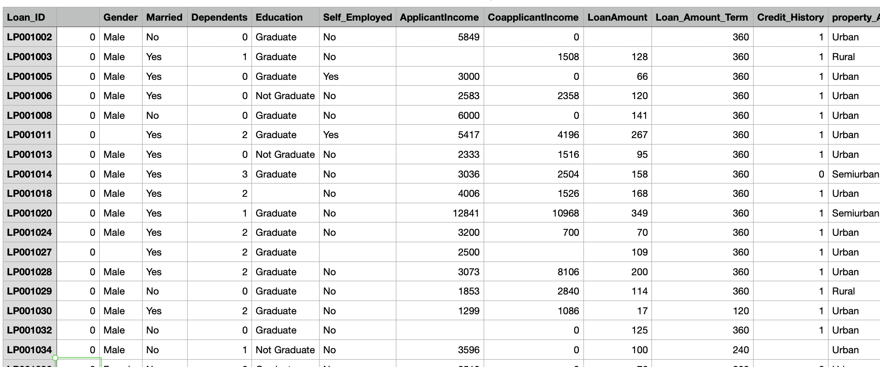
Raw Dataset - Snapshot

Slide 5
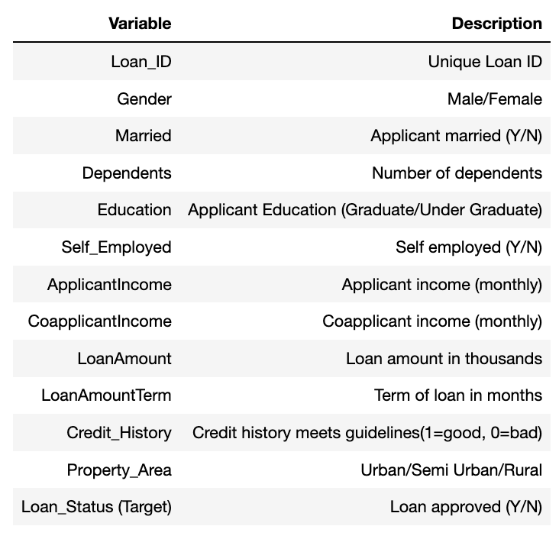
Data dictionary
Challenges
Missing Data Points
Outliers
Too many categorical variables
Different scale of datapoints

Slide 6
Objectives with modelling
(1) Understand the general segments of customers services by the company
(2) Objective 1: Assessing Eligibility for pending customers
(3) Objective 2: Estimated Loan Amount based on Customer Profile

Slide 7
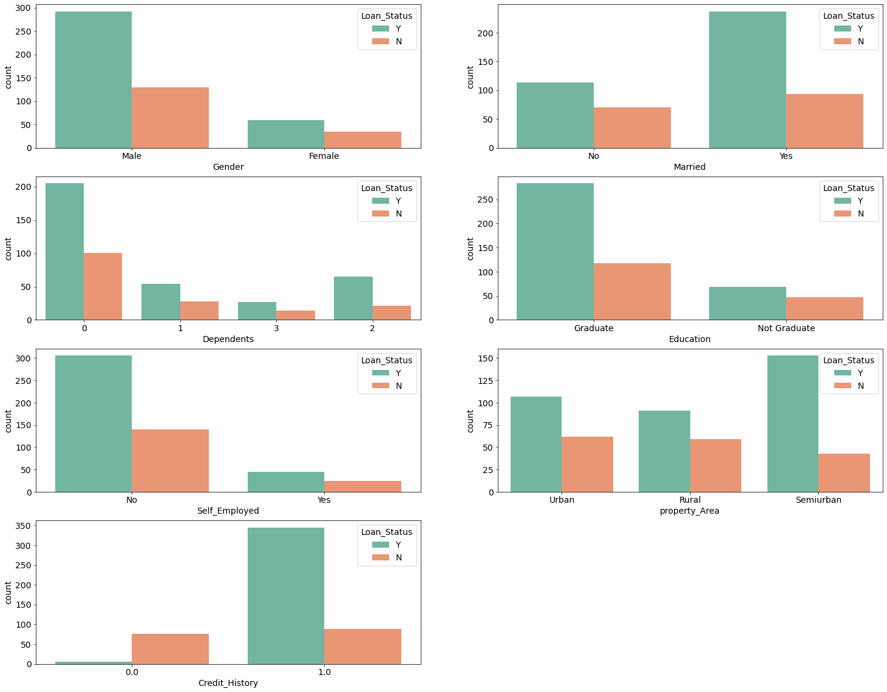
EDA Insights
Applicants tend to be Male Graduates who are employed
Most of the applicants tend to be from the Semi-urban neighbourhood
Majority of the customers tend to have no children or 1 child
Most of the applicants who were assessed to be eligible for the loan have had good credit standing in the past

Slide 8
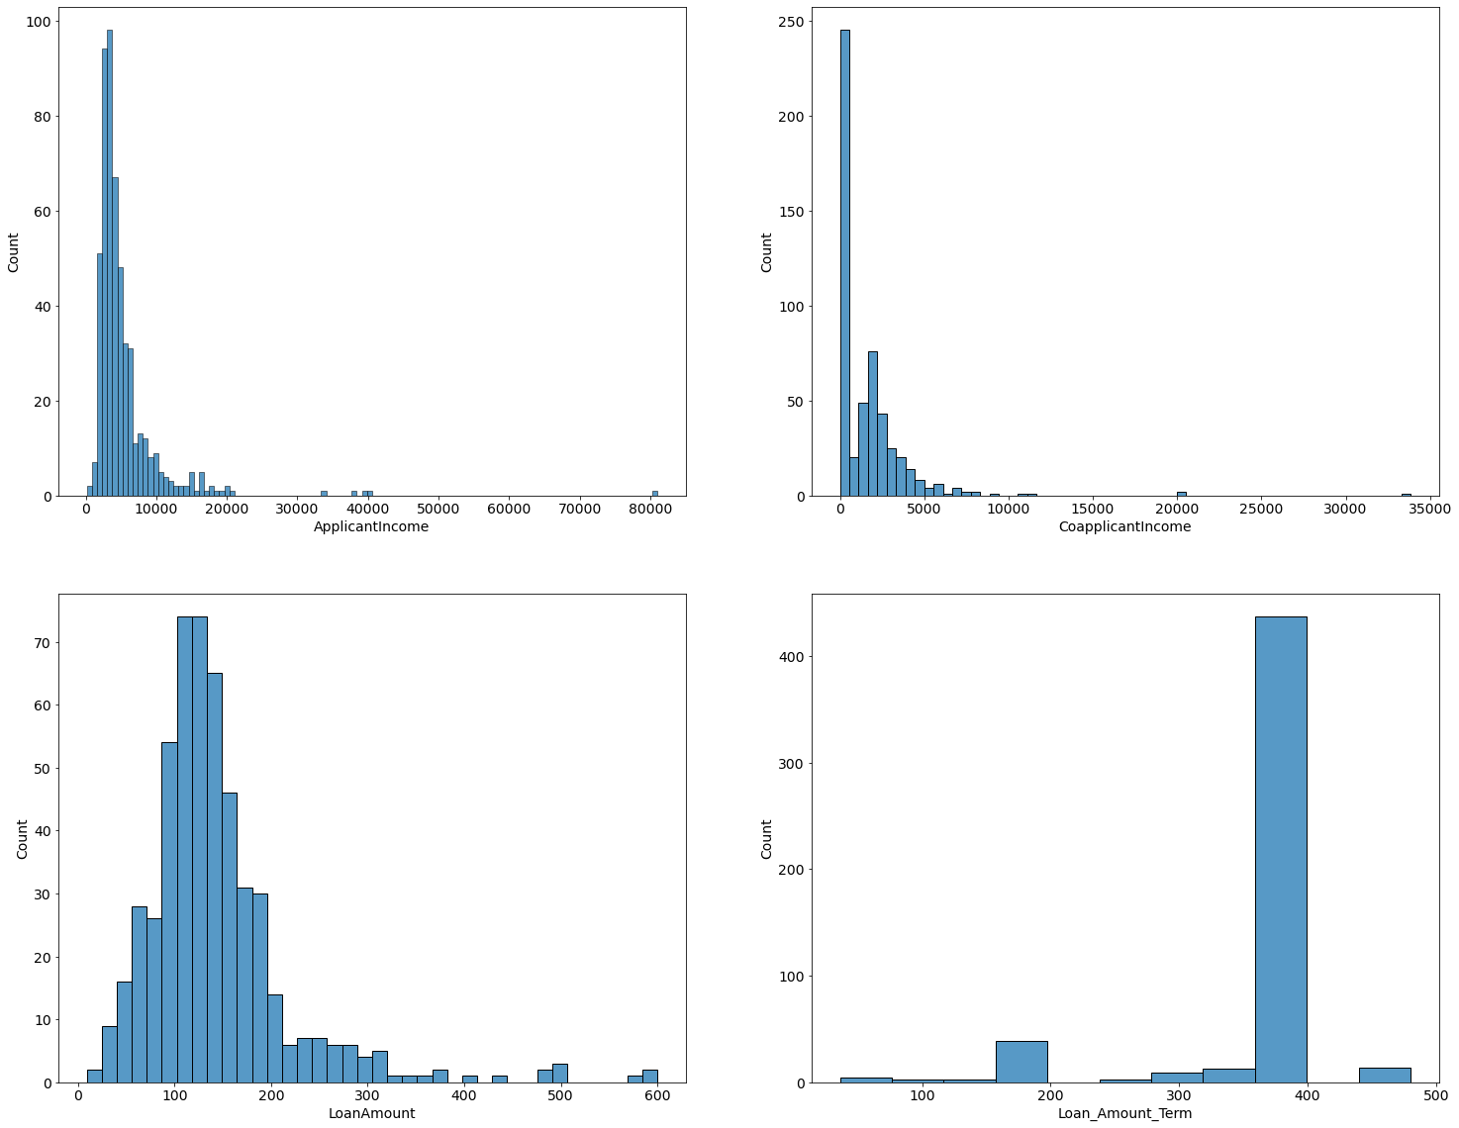
EDA Insights
Generally skewed income levels
Co-applicants tend to have lesser income that the actual applicants
Majority of the customers tend to have no children or 1 child
Loan amount distribution follows a similar pattern to that of the Applicant income
The most common tenor to borrow the loan at is 360 months

Slide 9
Objective 1: Customer Segments Services
Nature of problem: Clustering
Modelling techniques needed: K-means, DBSCAN, Hierarchical
Metrics: Silhouette Score
Challenges: How many clusters is good enough?

Slide 10
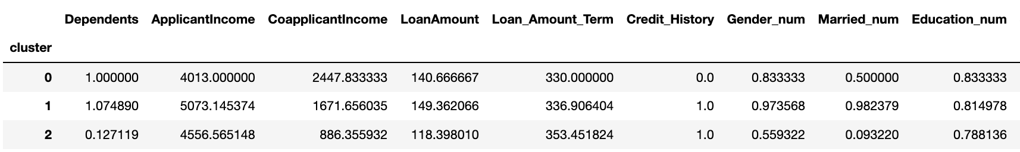
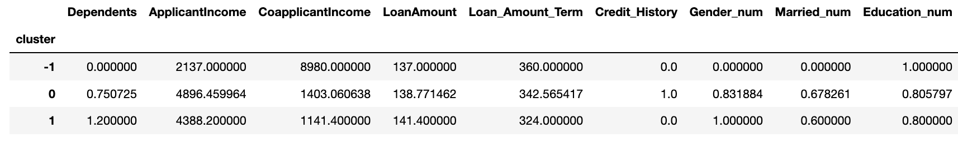
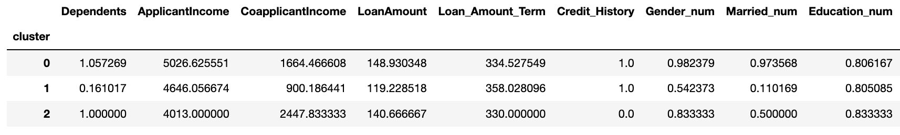
Clustering Model Results
K-Means
Silhouette Score
0.24674
DBSCAN
Silhouette Score
0.49499
Hierarchical Clustering
Silhouette Score
0.24135

Slide 11
Objective 2: Loan Eligibility
Nature of problem: Classification
Target variable is binary and a categorical variable (Yes or No)
Modelling techniques needed: Logistic Regression, KNN model
Metrics: Confusion Matrix (accuracy score)
Challenges: Conversion of the categorical variables, Scaling the variables

Slide 12
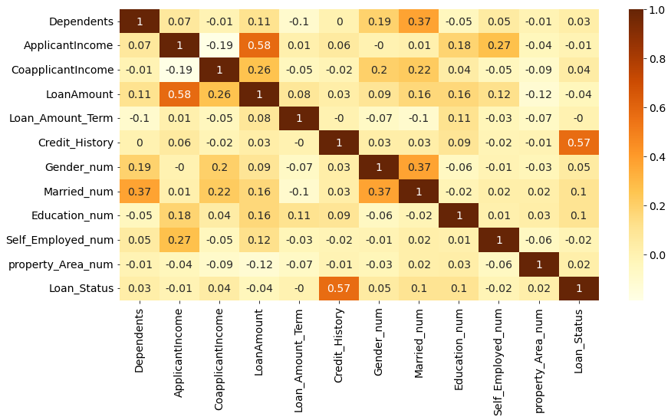
Correlation between variables

Slide 13
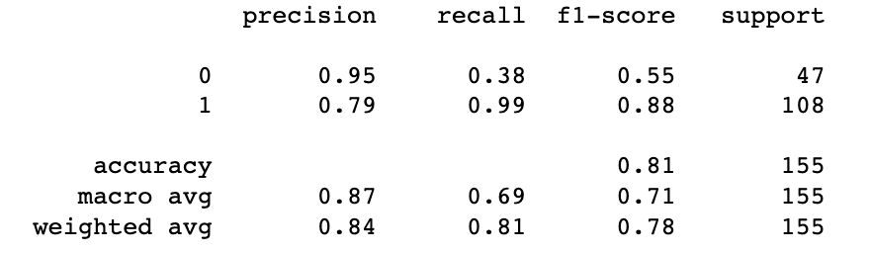
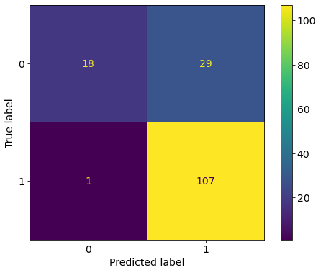
Classification Model Metrics
Logistic Regression
KNN Model

Slide 14
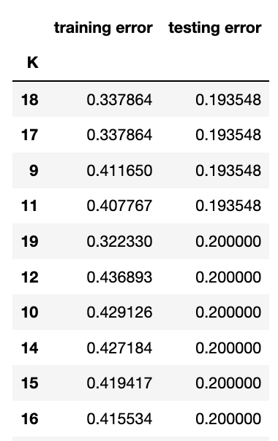
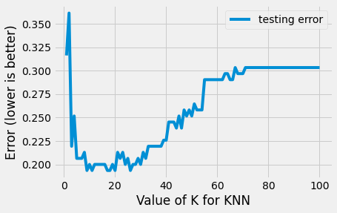
Classification Model Metrics
KNN Model

Slide 15
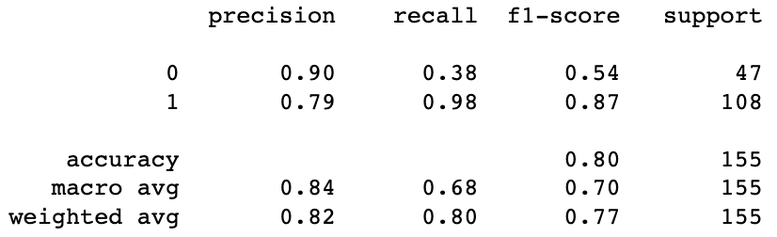
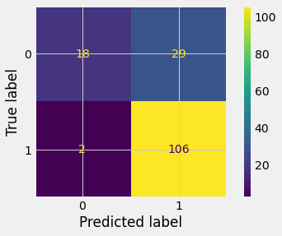
Classification Model Metrics
Logistic Regression
KNN Model

Slide 16
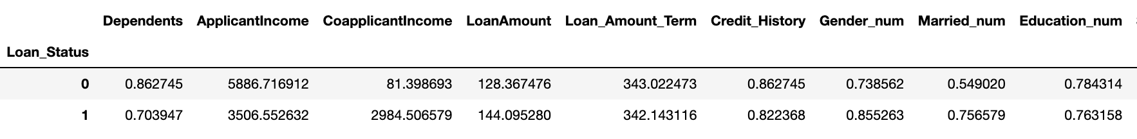
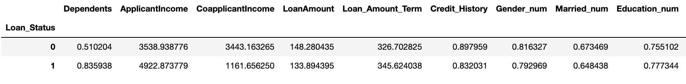
Classification Model Final Prediction
Logistic Regression – Works better as results aligns better with what we know about this dataset
KNN Model

Slide 17
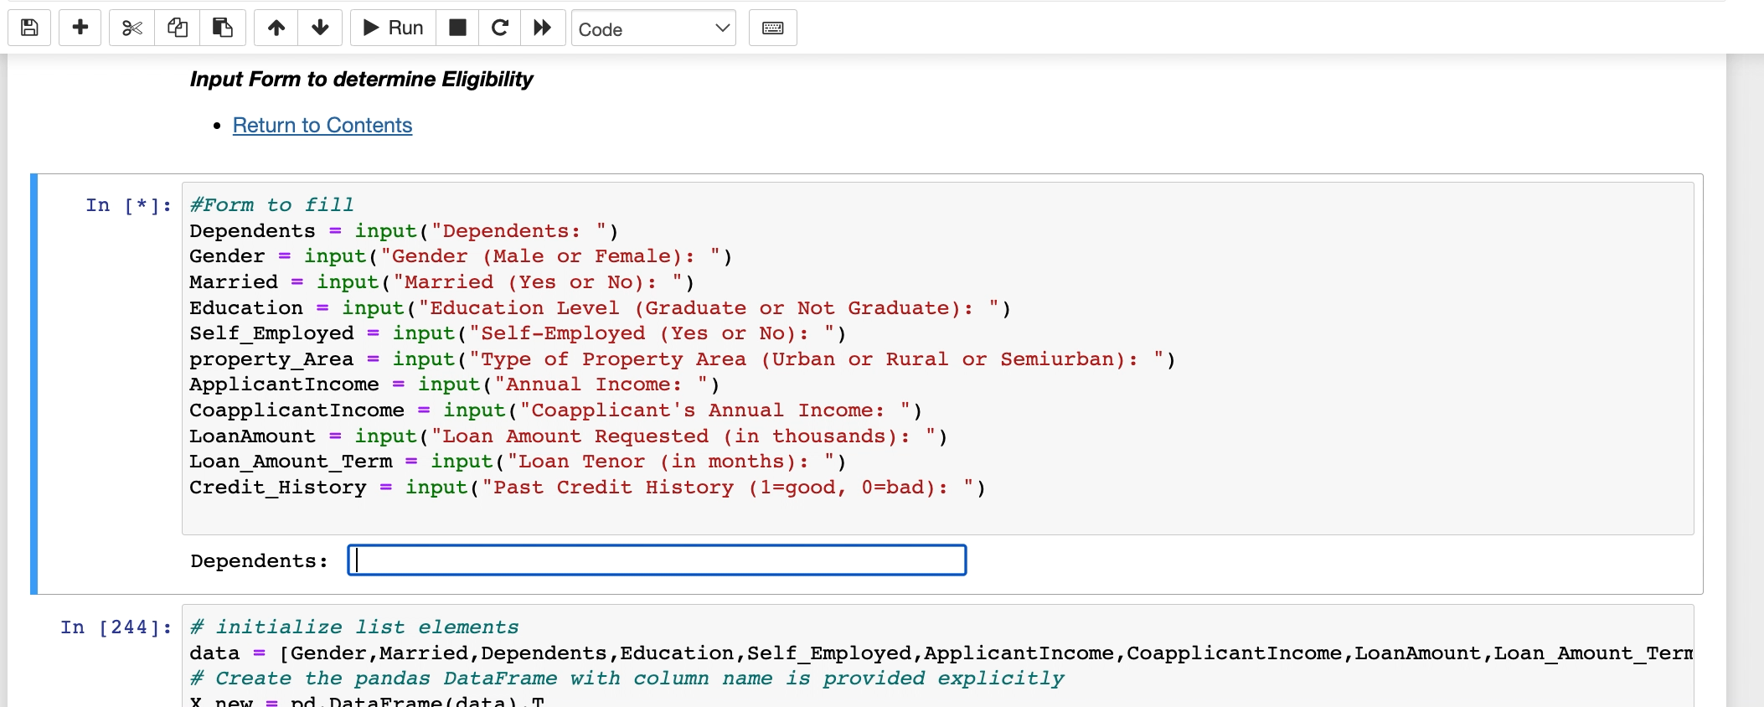
Running model on new data entry

Slide 18
Objective 3: Loan Amount Estimation
Nature of problem: Linear Regression
Target variable is the estimation on amount of loan to be provided
Modelling techniques needed: Linear Regression
Metrics: RMSE, Adjusted R^2 score
Challenges: Feature Selection, Scaling of variables

Slide 19
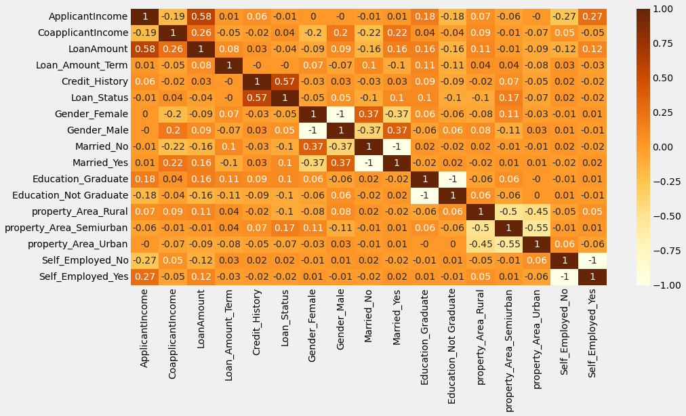
Correlation MAtrix

Slide 20
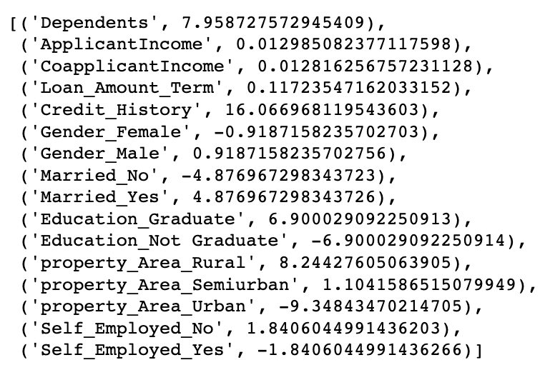
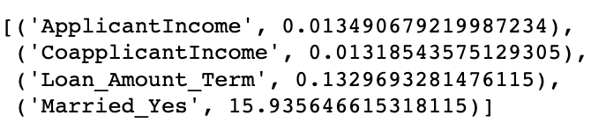
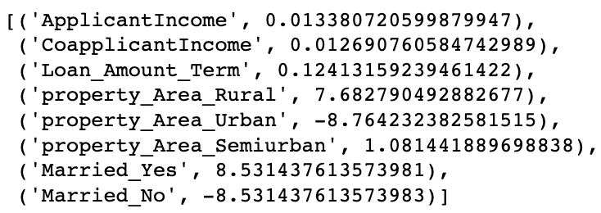
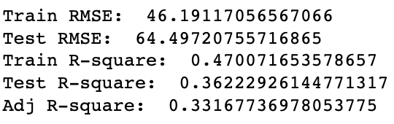
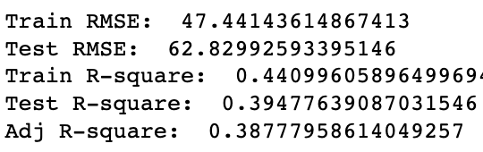
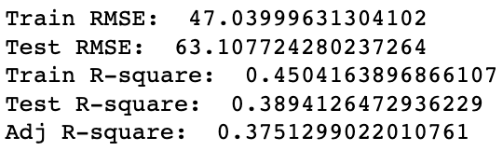
Linear Regression Results
Model 1 – All Variables
Model 2 – Stepwise Regression
Model 3 – Modified Model 2

Slide 21
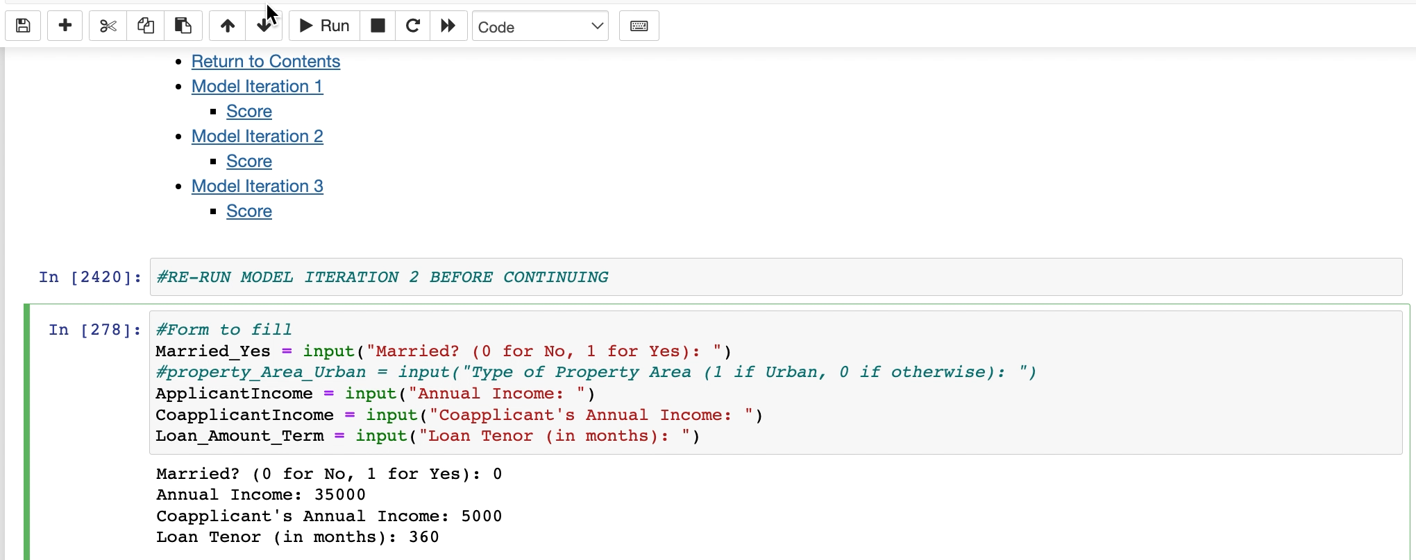
Running model on new data entry

Slide 22
Recommendations
Limited features availability and limited time series data impacts the accuracy of the prediction, and might yield better models – gather better quality data in larger quantities
Human error may be a key inhibiting factor – implement controls on data input to ensure that ”fat finger” mistakes are avoided when making assessment
Make certain fields mandatory - Employment status, Education, Income amounts, dependents etc.
Modelling
Logistic regression offers better prediction capabilities that aligns with our understanding of the customer segments
Linear regression models could have been improved with more features, and larger sample of data
To improve their prediction accuracy, they should fine tune their models regularly with more data being collected and stored

